Slide 1

Human Potential Unlimited

Slide 2
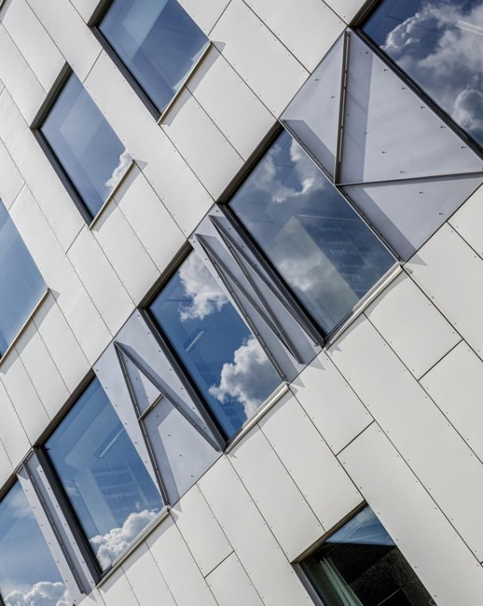
Tampere University of Applied Sciences
TAMK is one of the largest and most popular universities of applied sciences in Finland. Our strengths are multidisciplinarity, development competence, diverse learning paths, close contacts to working life and international cooperation. We constitute the Tampere Universities community together with Tampere University.

Slide 3

Third largest university of applied sciences in Finland
around 11,000 students
more than 50 degree programmes
around 750 employees

Slide 4


International cooperation
335 cooperation partners in 55 countries
Student and staff exchanges
International theme weeks
Summer School
Intensive courses
International projects and cooperation networks

Slide 5
How to apply for exchange studies at TAMK
Students applying to TAMK as exchange students must have completed at least one year of study at their home university before the exchange at TAMK starts.
HdM must nominate you to TAMK first
The length of a study exchange: one or two semesters:
Autumn semester (August - December)
Spring semester (January - May)
Media and Arts courses (S2023)

Slide 6
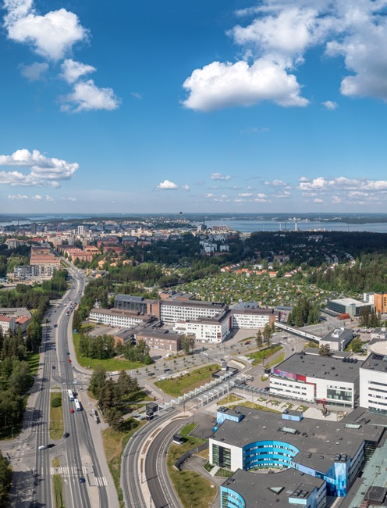
TAMK’s schools
TAMK’s schools steer core operations in such a way that education, RDI and paid services are seamlessly connected to one another.
School of Business and Media
School of Pedagogical Innovations and Culture
School of Built Environment and Bioeconomy
School of Social Services and Health Care
School of Industrial Engineering

Slide 7

TAMK – new competence for working life
Our strategic objectives
We are the most international higher education institution
We are the most desired working life partner
We reform education contents and structures
Our values
T We work in a globally responsible manner
A We value activeness, learning and competence
M We succeed by doing together
K We respect diversity in our community

Slide 9

TAMK
Media & Arts
Studies for Exchange Students
Sohvi Sirkesalo
International Coordinator
+358 50 3293938
sohvi.sirkesalo@tuni.fi

Slide 10
TAMK
Media & Arts
Studies for Exchange Students
Sohvi Sirkesalo
International Coordinator
+358 50 3293938
sohvi.sirkesalo@tuni.fi

Slide 11
Structure of Studies: minor + optional courses
Each semester we offer 6-7 MINORs
One minor = 30 Credits,
incl. 5 courses:
3 theoretical / hands on courses (5 ECTS each)
2 project courses (5+5 ECTS)
Projects can be
cooperation with a company, enterprice, organization – a client outside of University
OR
students own ideas

Slide 12
Minors / semester
Autumn semester
Interactive Media
Animation
User Experience Design
Fine Art
Photography
Applied Fine Art
Music Production
Music Business and Production
Emerging Media in Music Production
For all
Game Academy
Working as an entrepreneur

Slide 13
Minors / semester
Spring Semester
Interactive Media
Web and App Design and Development
Visual Design
Fine Art
Moving Image
Advanced Fine Art
Music Production
Live Event Production and Technology
Sound Design
For all
Cultural Export
Emerging Media Production
https://opinto-opas-ops.tamk.fi/index.php/en/167/en/49588/22KVDMASPRING23/year/2022

Slide 14
Projects, events, networking in Tampere,
Finland
Some events
Tampere Film Festival 8.-12.3.2023
Eye on TAMK International Week 20.-24.3.23
Music X Media (September-October 2023)
VFX – education
XR Factory
Womex 2019 in Tampere!
Feel free to contact Sohvi Sirkesalo
sohvi.sirkesalo@tuni.fi

Slide 15

Follow, participate
tuni.fi/tamk
Facebook TAMK - Tampere University of Applied Sciences
Twitter TAMK_UAS
Instagram tamk_uas, tamk_international
LinkedIn Tampere University of Applied Sciences
TikTok TAMK_UAS
YouTube Tampere Universities
TAMKjournal tamkjournal.tamk.fi
Unit-lehti tuni.fi/unit-magazine

Slide 16

Human potential unlimited

